Slide 1
Advanced pcb lab
Marvin the hackbut
By Ben De Lathouwer

Slide 2
Agenda
Introduction
Why this prodject?
Electronic schematic overview and comparison
Overview for V4 inprovments
What did Iearn?
Questions

Slide 3
Goal of advanced pcb lab
To make a PCB
Debugging
Soldering
Using Altium

Slide 4
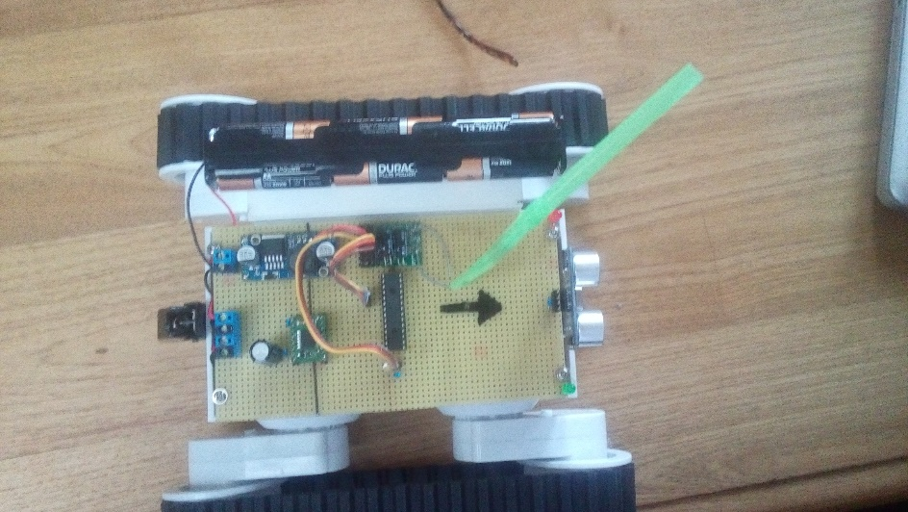
Why this prodject
Improvement of the practice enterprise course
Mechatronicais fun

Slide 5
Main microcontroller
Purpose
Generating data for esp8266
Controlling levelshifter
Encoders uitlezen
receiving data from the secondary controller

Slide 6
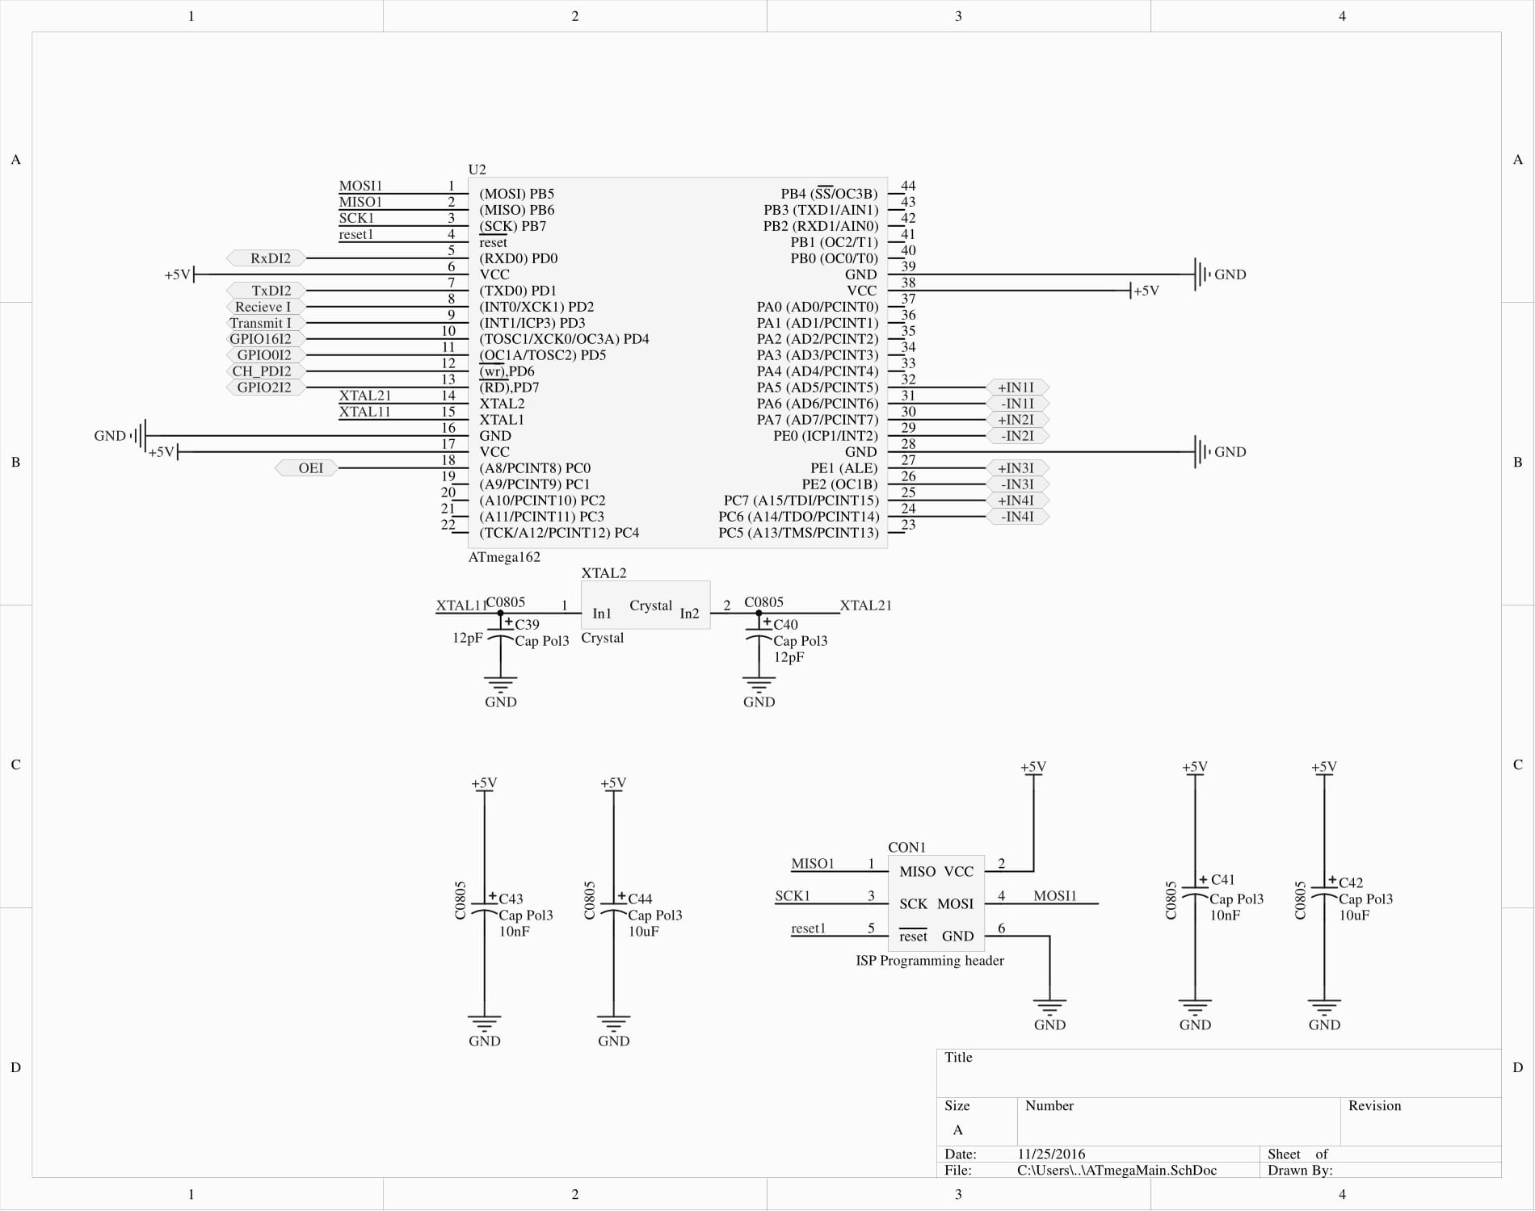
Main micro controller V2

Slide 7
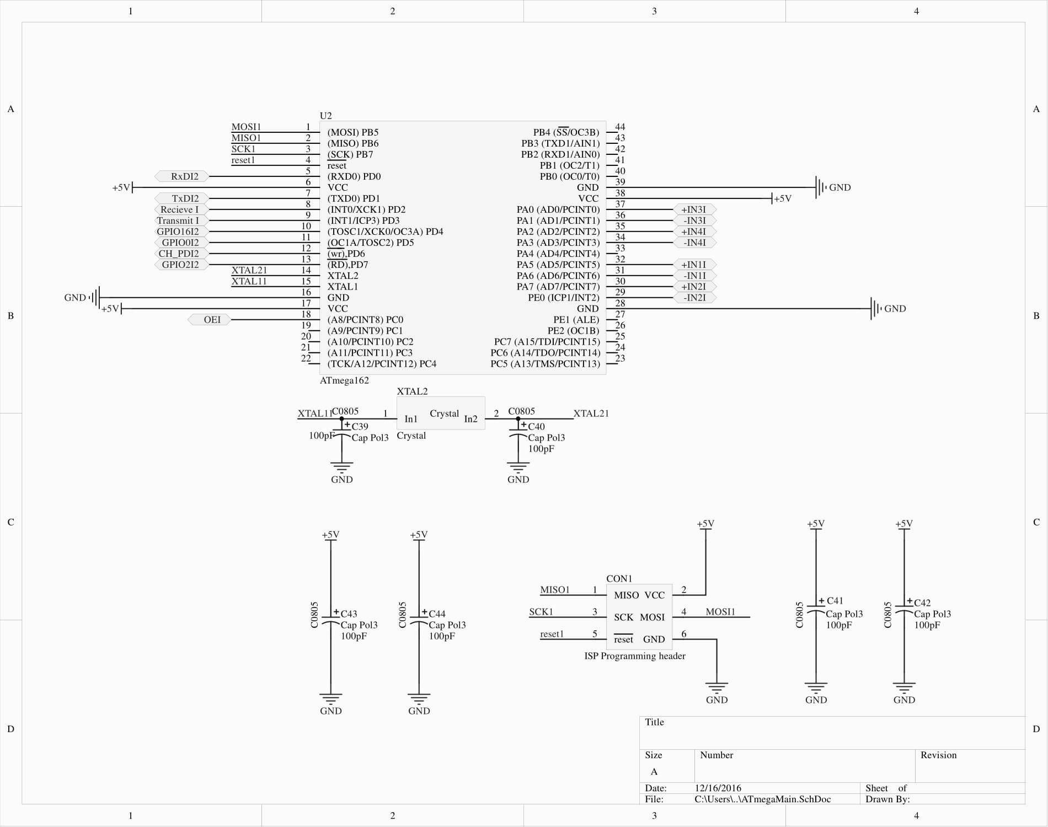
Main microcontroller V3

Slide 8
Secondary micro controller
Purpose
Generating motor driver pwm
Controlling motordriver
sending data to the main microcontroller
Controlling and reading the hc-sr04

Slide 9
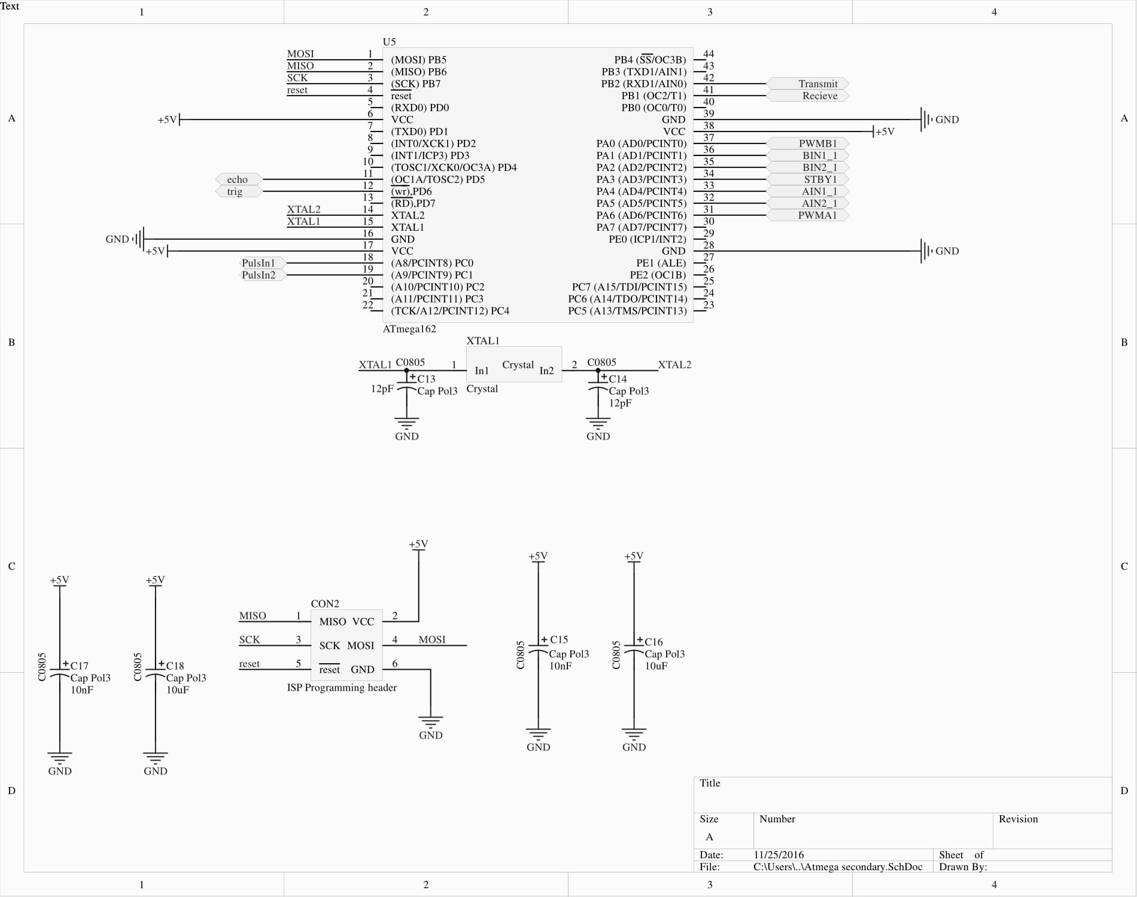
Secondary micro controller V2

Slide 10
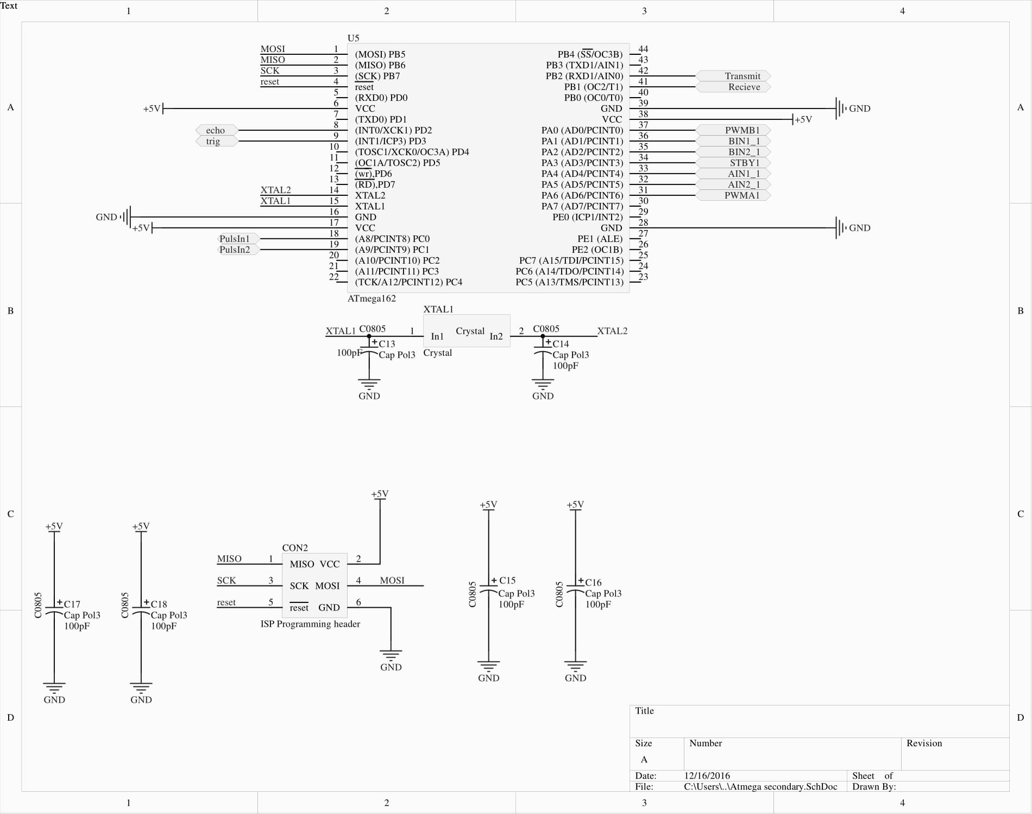
Secondary micro controller V3

Slide 11
Why to microcontrollers?
Taking load of the controller(interrupt wise)
Relatively more i/o available

Slide 12
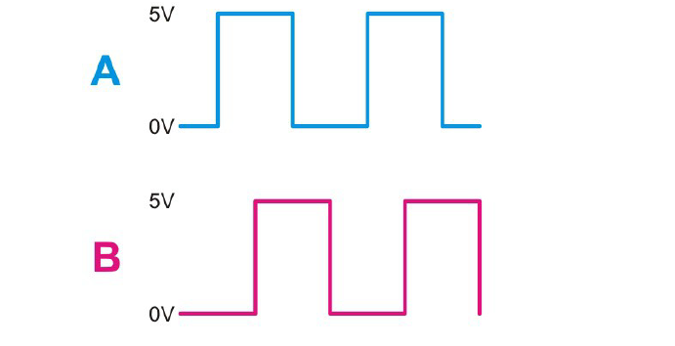
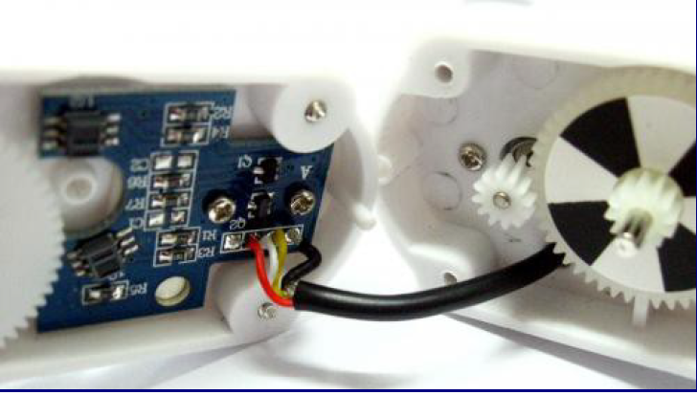
Encoders
Rover chassis=> quadrature encoders
Number of sensors can be used
Optical(IR pair) => whit black and withe surfaces
Magnetical(hal sensor) => magnet on a shaft
Pulses 90degrees out of phase =>direction

Slide 13
Encoder improvements
Merging 2 encoder outputs
Via xor gate
Advantages
Less i/o pins used
Less interrupts used
Disadvantages
One component extra
No direction sensing

Slide 14
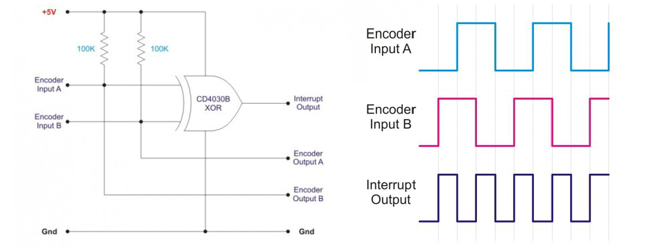
Encoder improvements

Slide 15
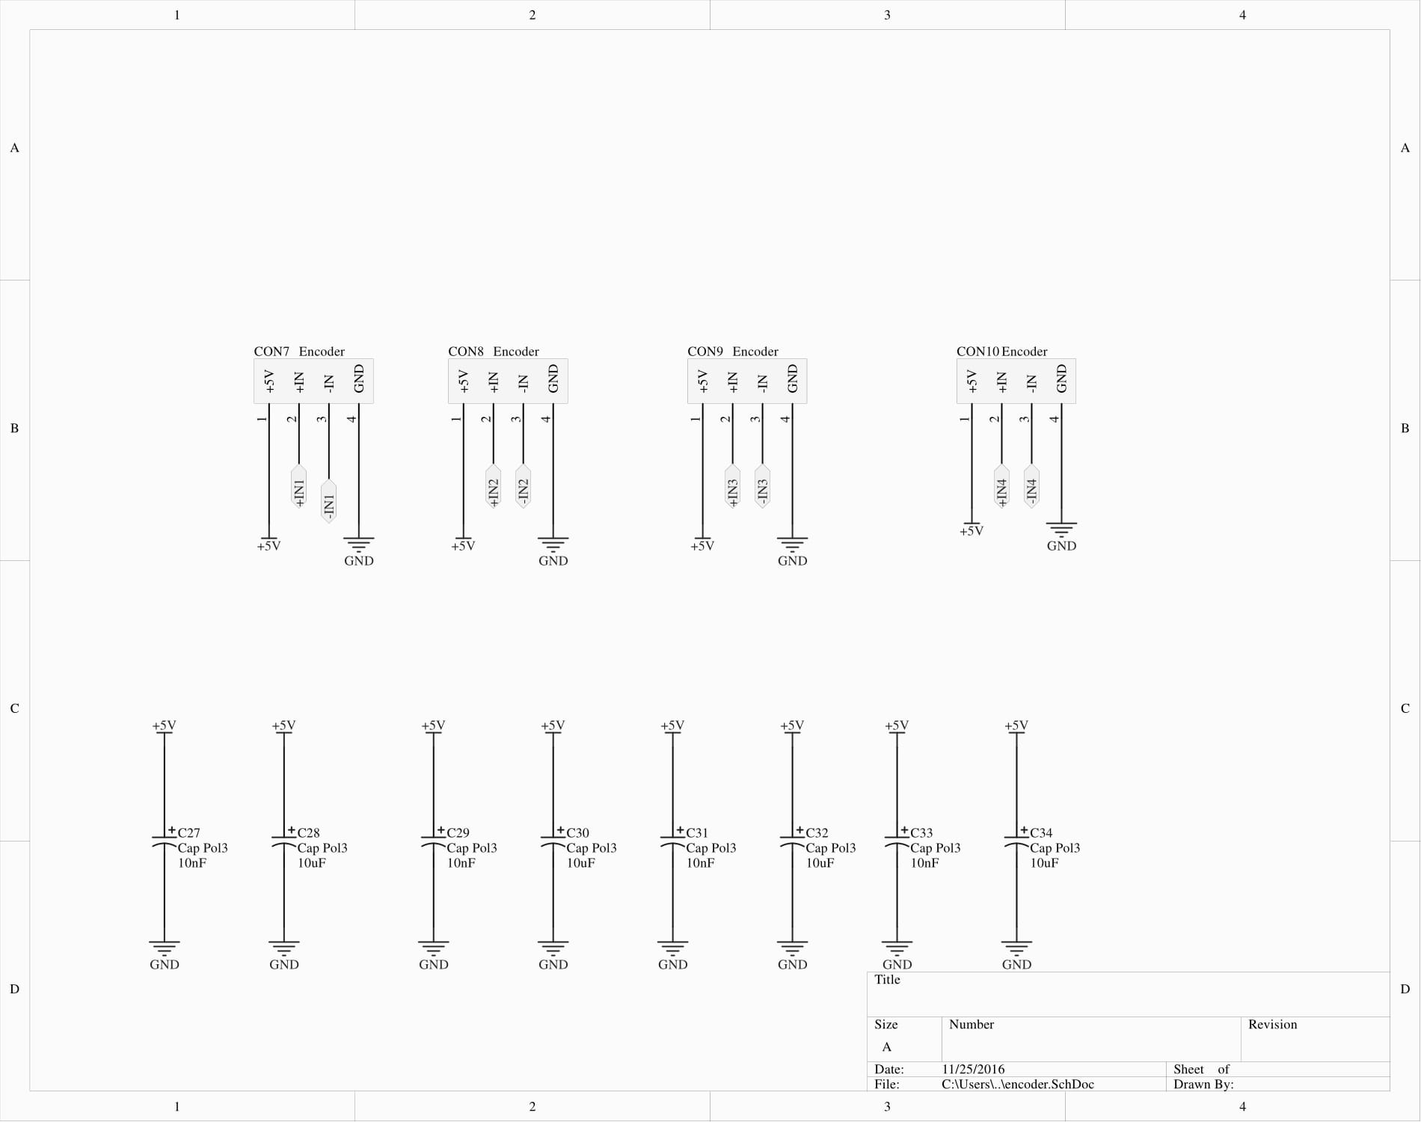
Encoders V2 & V3

Slide 16
ESP8266
Cheap wifi module (6 euro’s)
with onboard System On chip
Communicating protocol=> AT commands via serial port
No components under the antenna!
3.3V ONLY!!! No 5V tolerant I/O

Slide 17
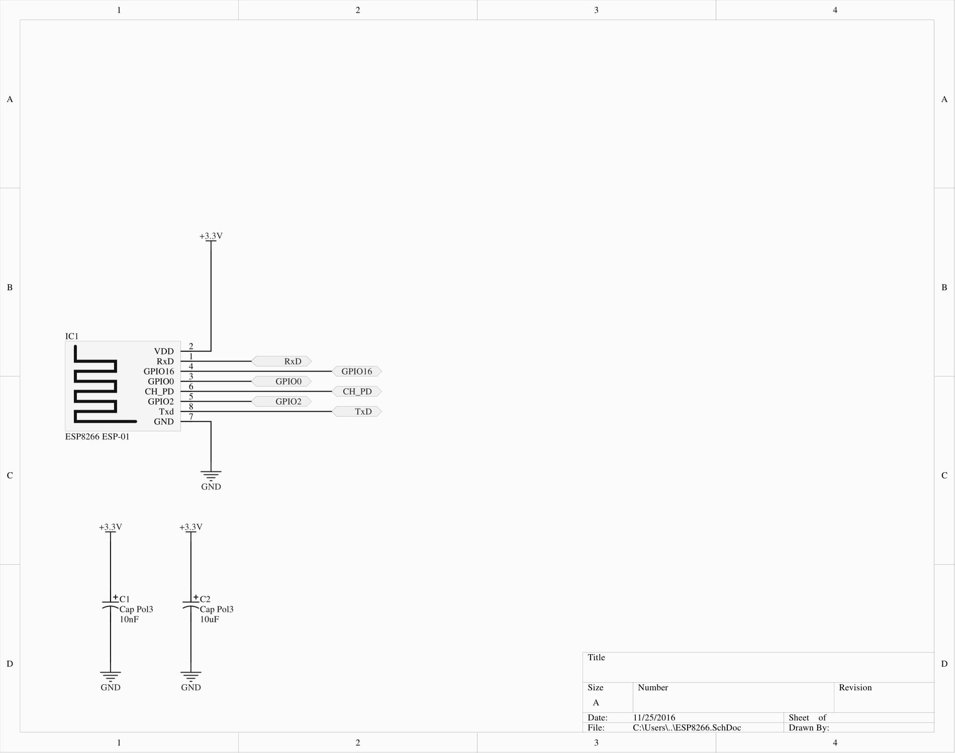
ESP8266 V2 & V3

Slide 18
Level shifter
Converts signal other voltage level
For example 3.3V to 5V and vice versa
TXB0108 uses 2 voltage supply’s
Vcca => 1.2V to 3.6V
Vccb =>1.65V to 5.5V
Needs to be used because of the esp8266
Level shifter needs to be enabled via OE pin

Slide 19
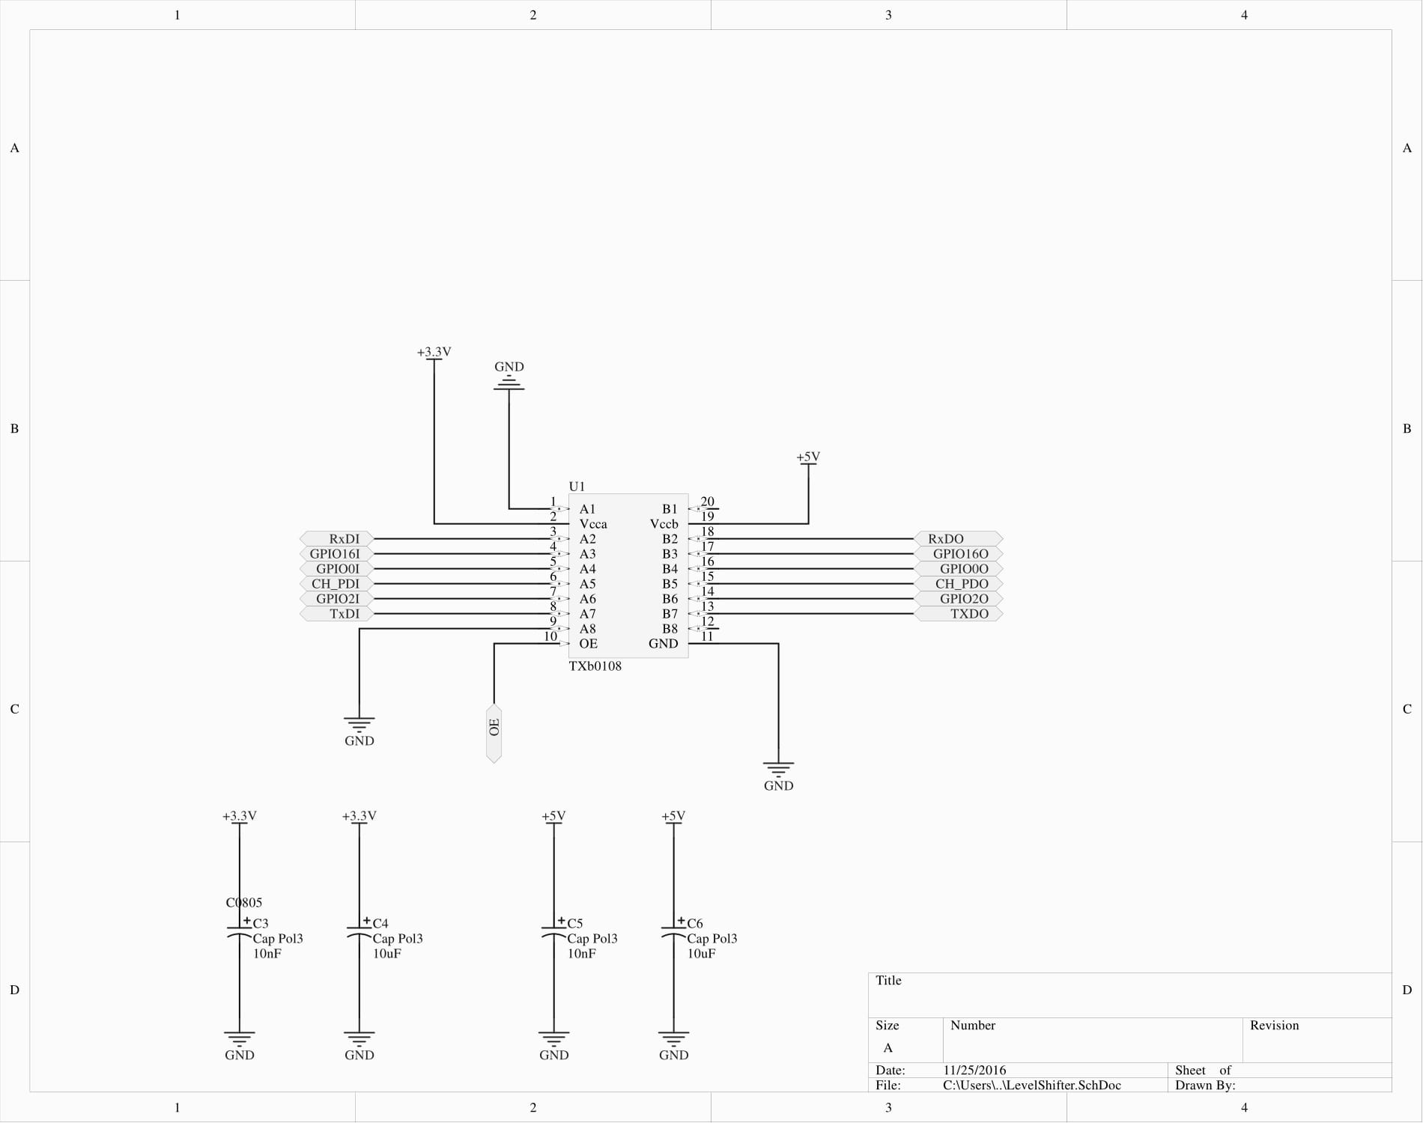
Level shifter V2 & V3

Slide 20
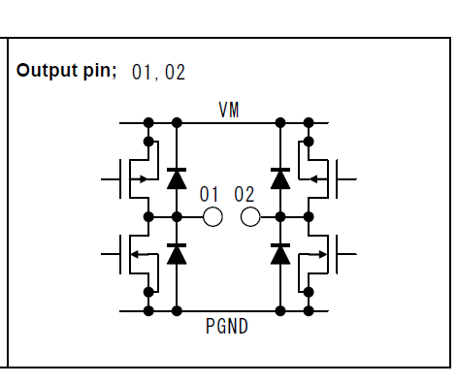
Motor driver
Using h-bridge
TB6612FNG
Integrated H-bridge with integrated control circuitry and diodes
No need to worry about short circuiting / destroying the internal mosfets
Iout 1.2A Max with peak current up to 3.2A

Slide 21
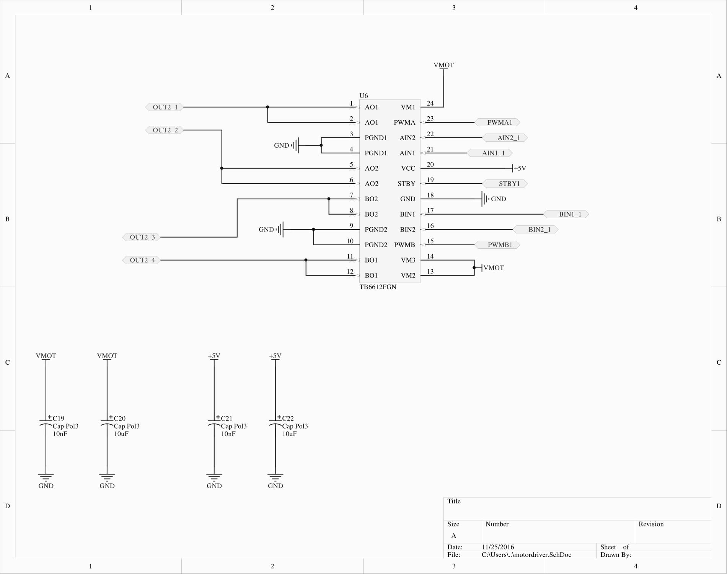
Motor driver V2 & V3

Slide 22
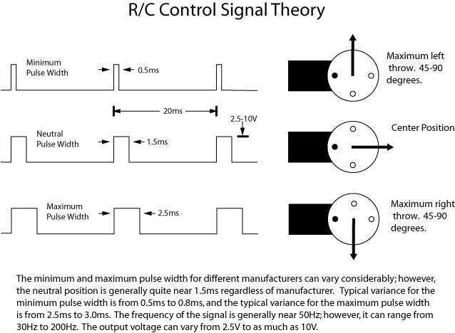
Rc reciever
Standart modelling rc receiver
Servo output
Wirles communication
Gets transformd into
Pwm signal

Slide 23
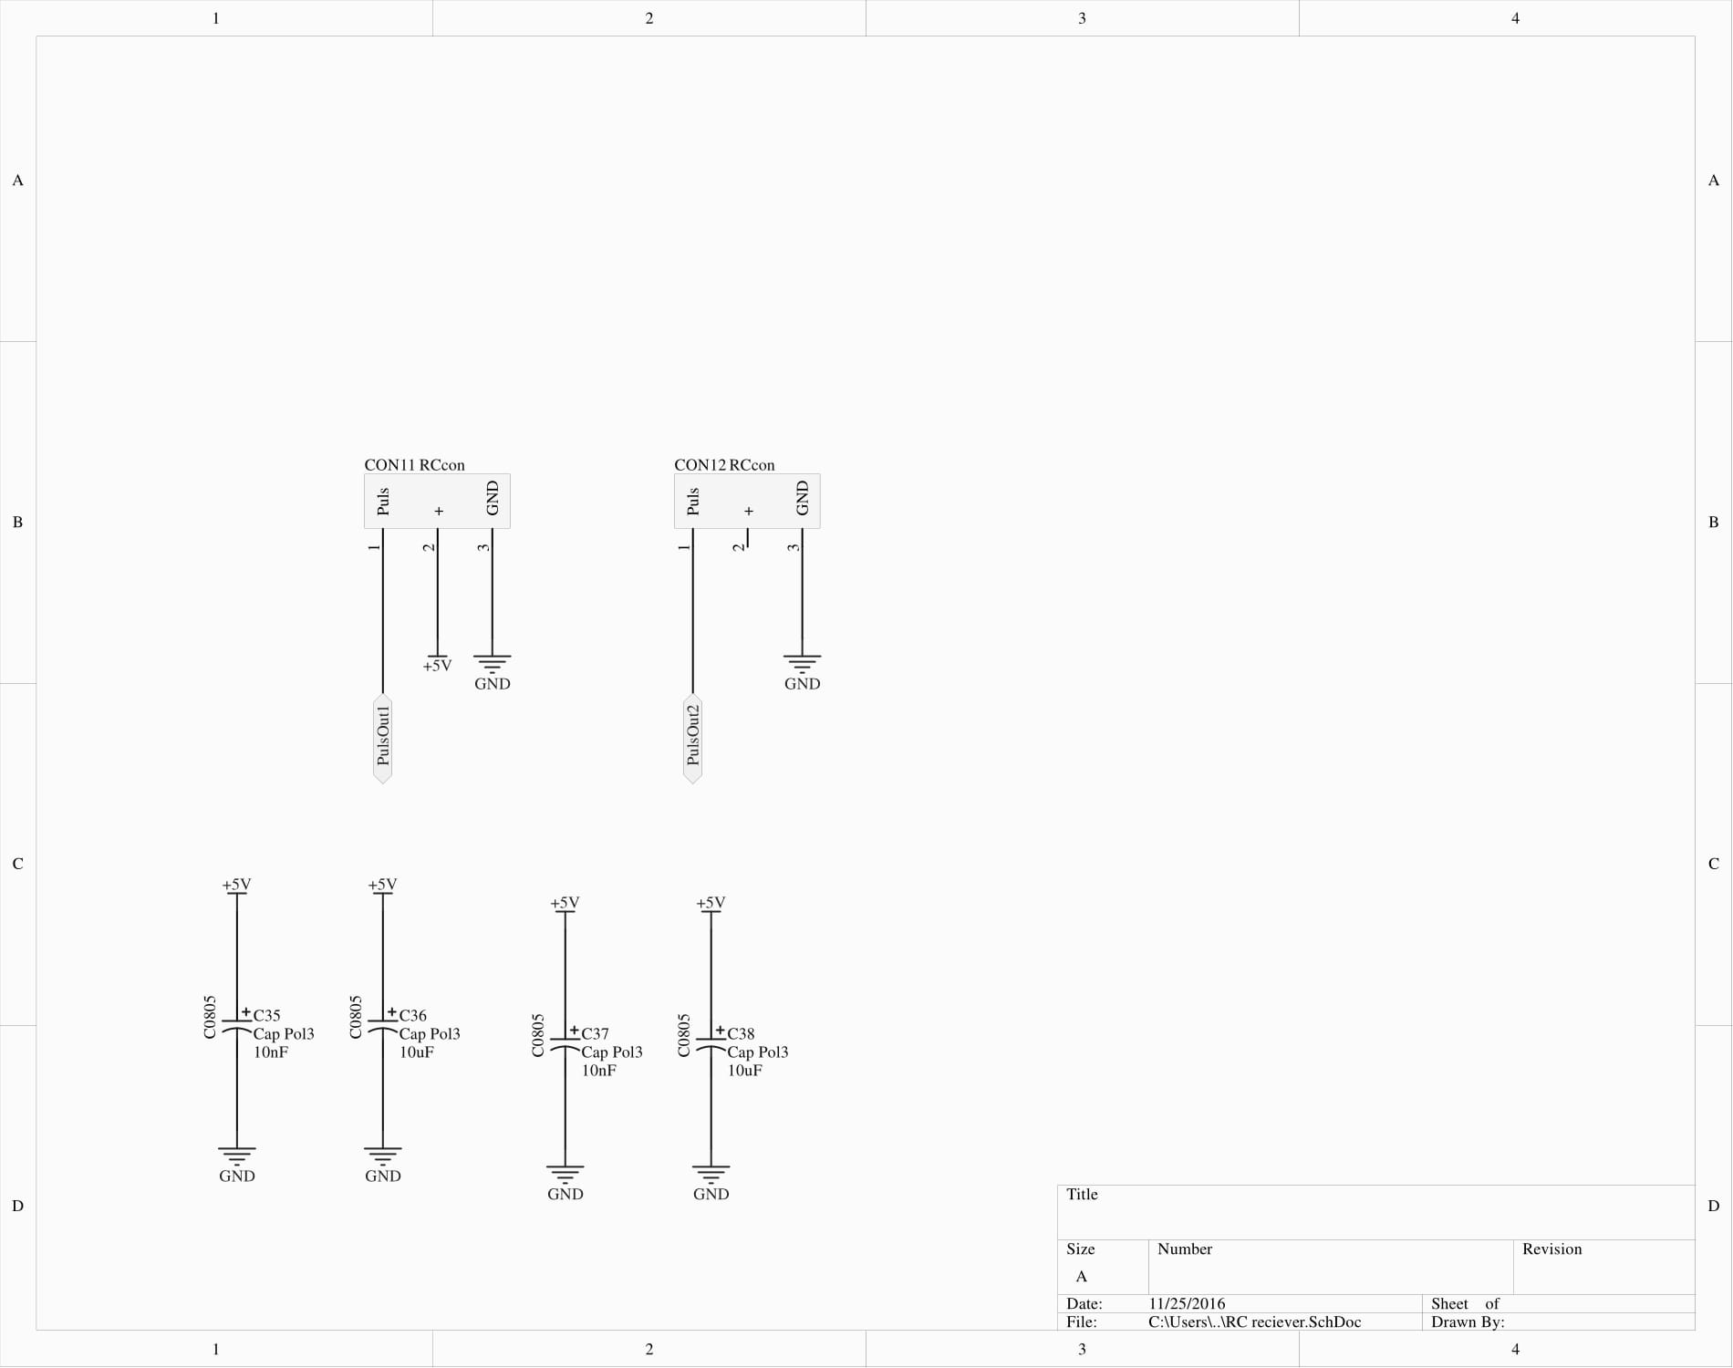
Rc receiver V2 & V3

Slide 24
Ultrasonic distance sensor
Measurement using sound
4 pins
Gnd, vcc, triger input and echo output
Echo puls with proportional to distance
distance = high level time * velocity / 2
High level= duration of puls with(milli or micro seconds)
velocity = 340m/s( speed of sound)

Slide 25
Ultrasonic distance sensor
Ranging distance = 4cm to 4meters
Detection angle is 15 degrees

Slide 26
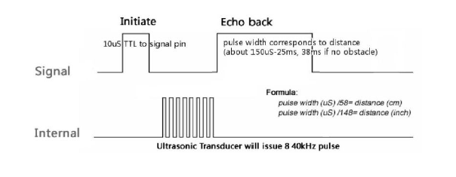
Theoretical signals

Slide 27
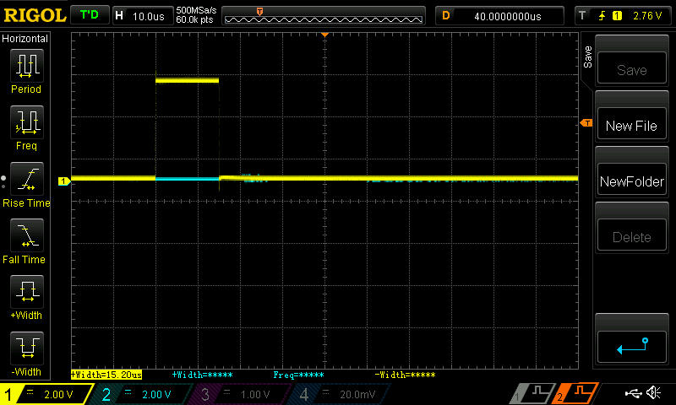
Trigger puls

Slide 28
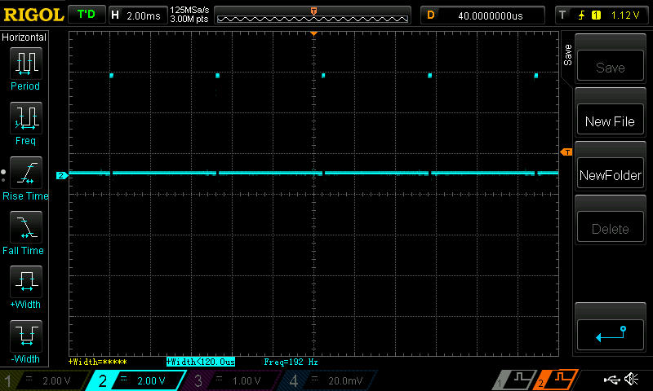
Echo puls minimum distance

Slide 29
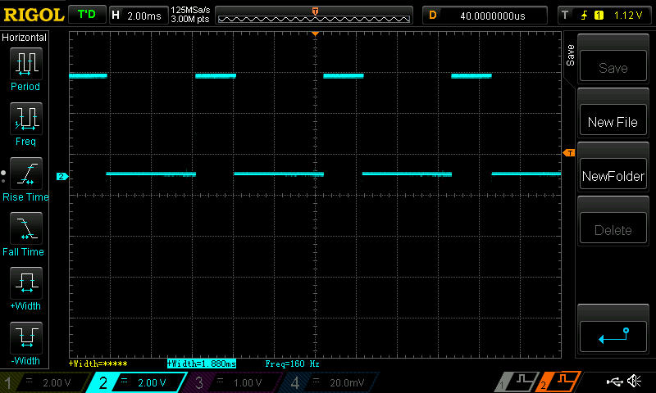
Echo puls max distance

Slide 30
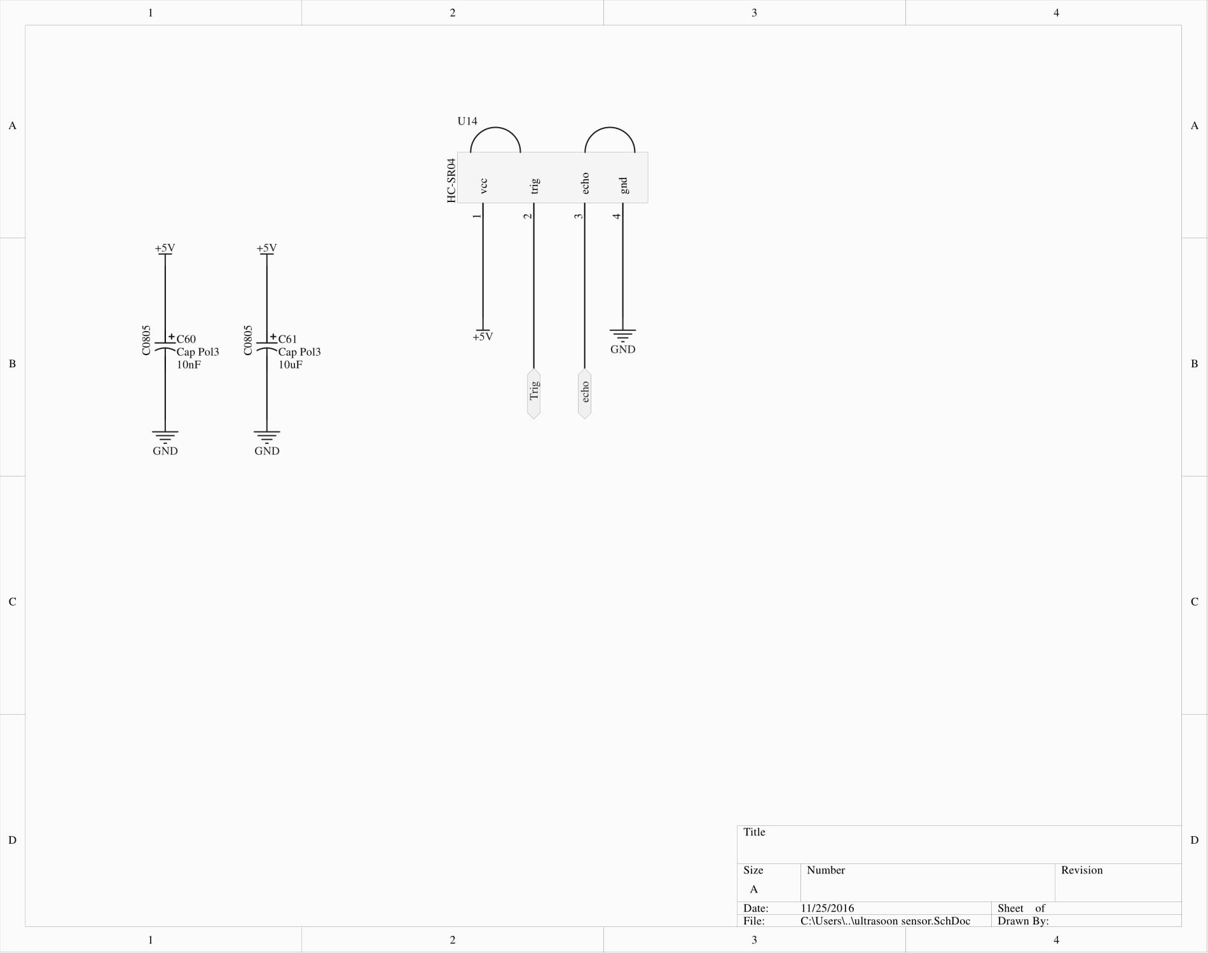
Ultrasonic distance sensor V2 & V3

Slide 31
Power supply
Uses ldo’s
Low dropout voltage
Used to generate 5V and 3.3V for control electronics and ESP8266

Slide 32
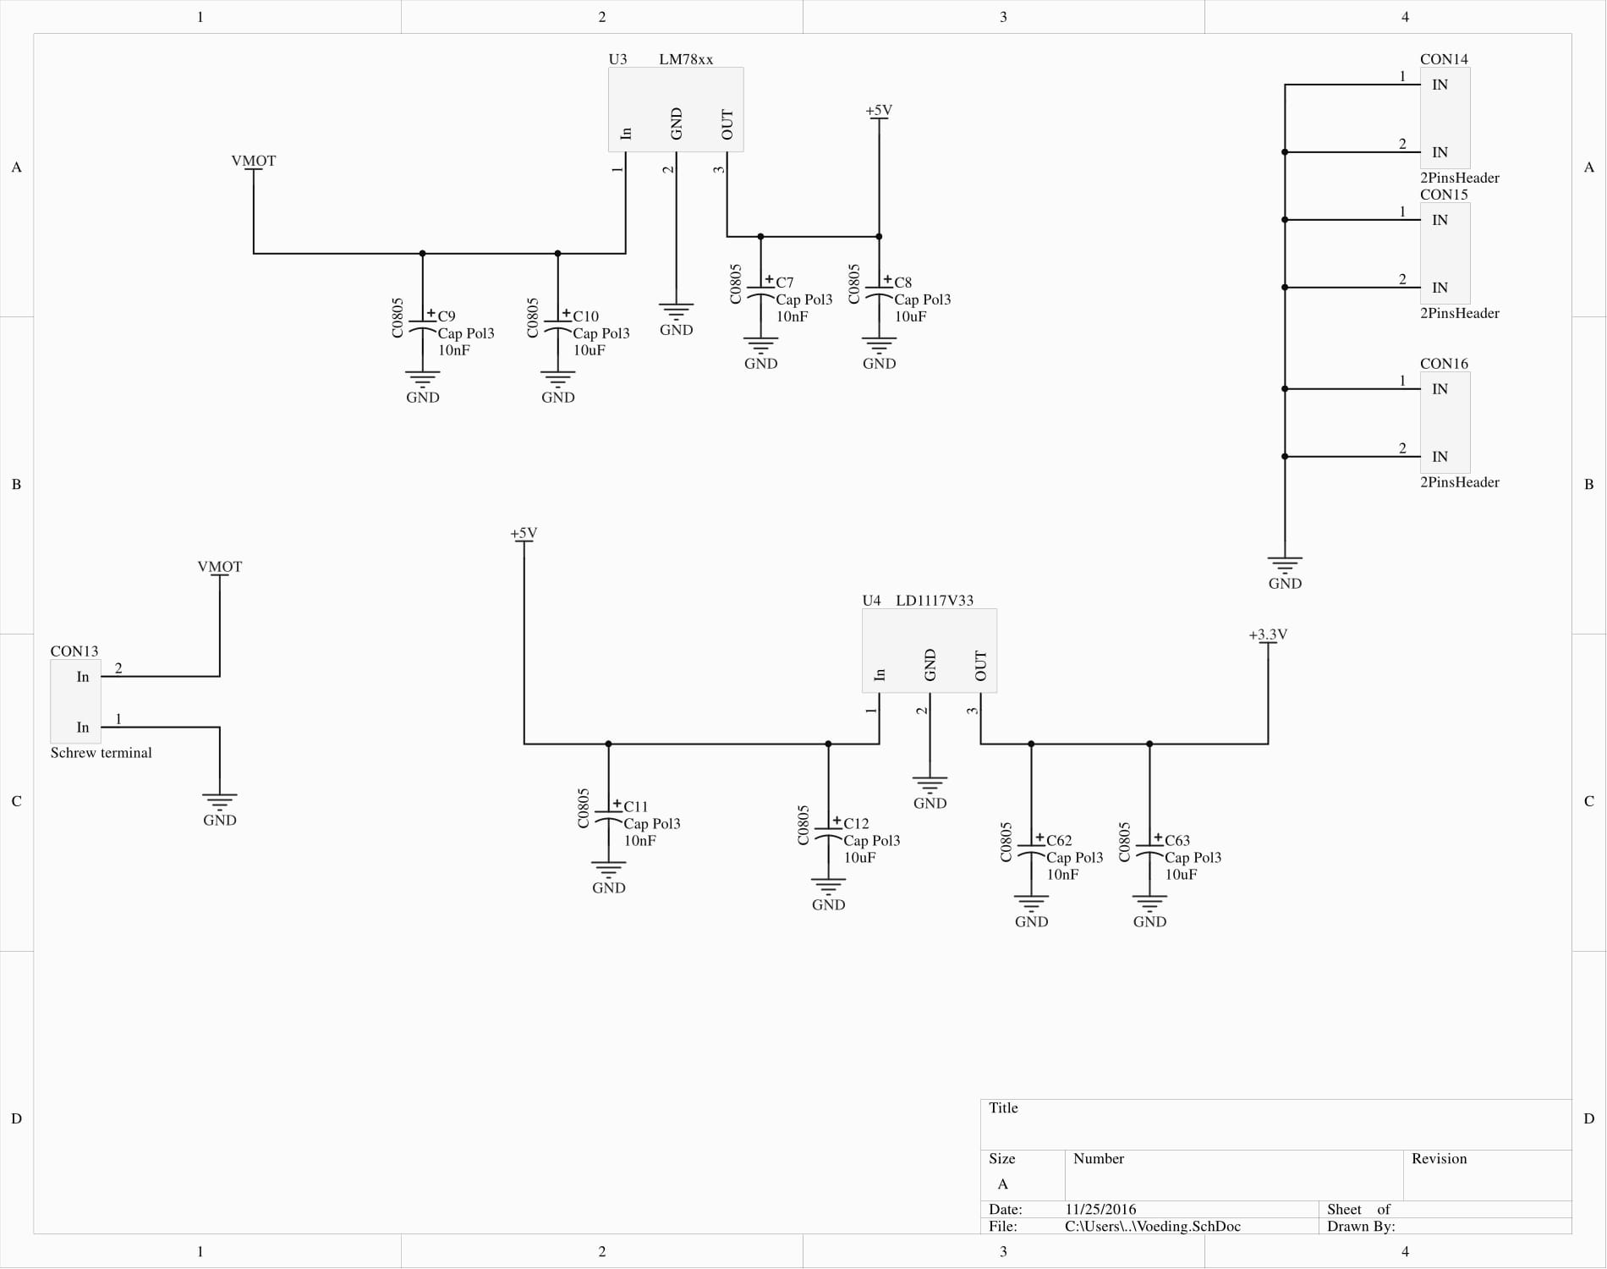
Power supply V2

Slide 33
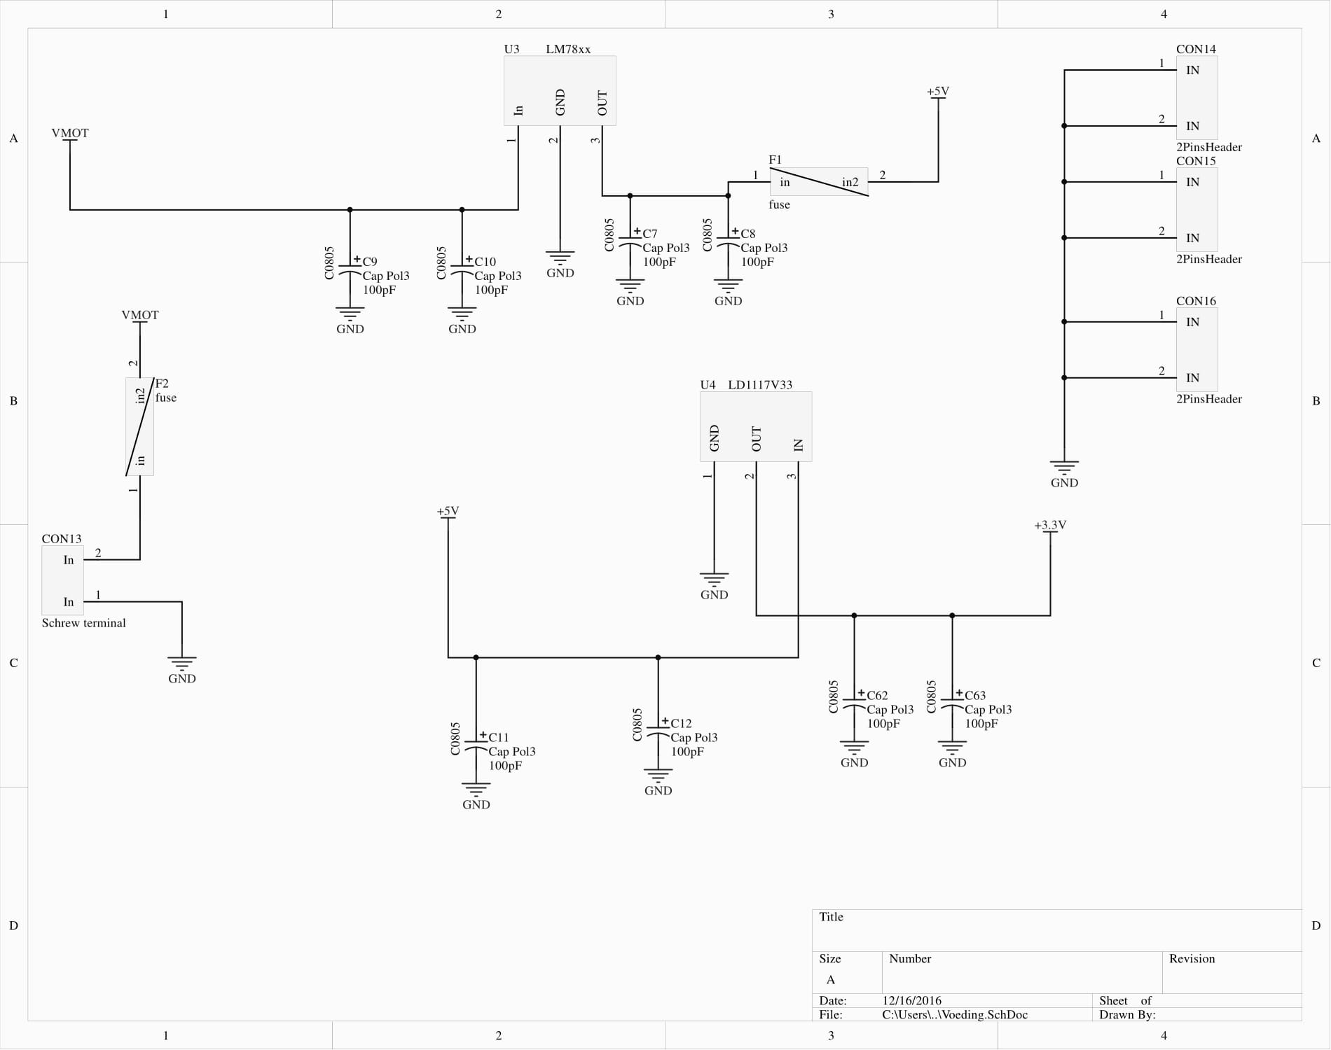
Power supply V3

Slide 34
Improvments for V4 pcb
Utilizeing current sensors
Using a better microcontroller
More periffery
Reseizing the board

Slide 35
What did I learn ?
Circuit design
Think first then design
First reading the datasheet
Then draw footprints etc.
High current design
Using Altium
Notes:
used the wrong interrupt source

Slide 36
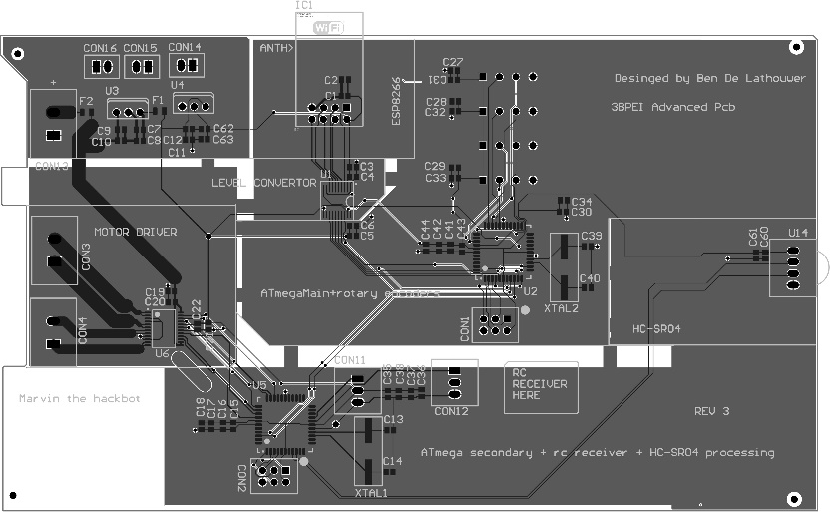
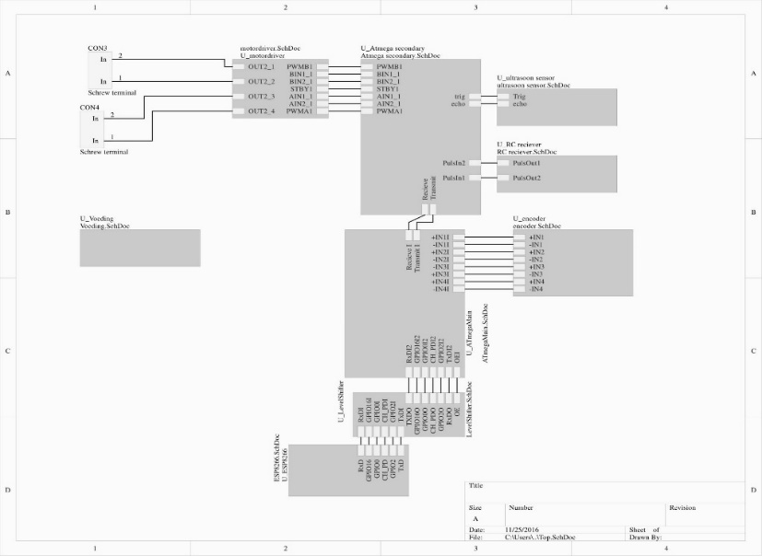
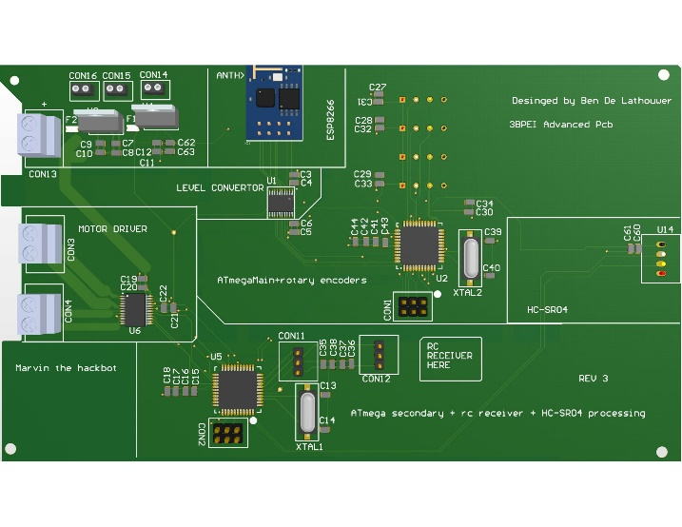
Questions?

